Slide 1
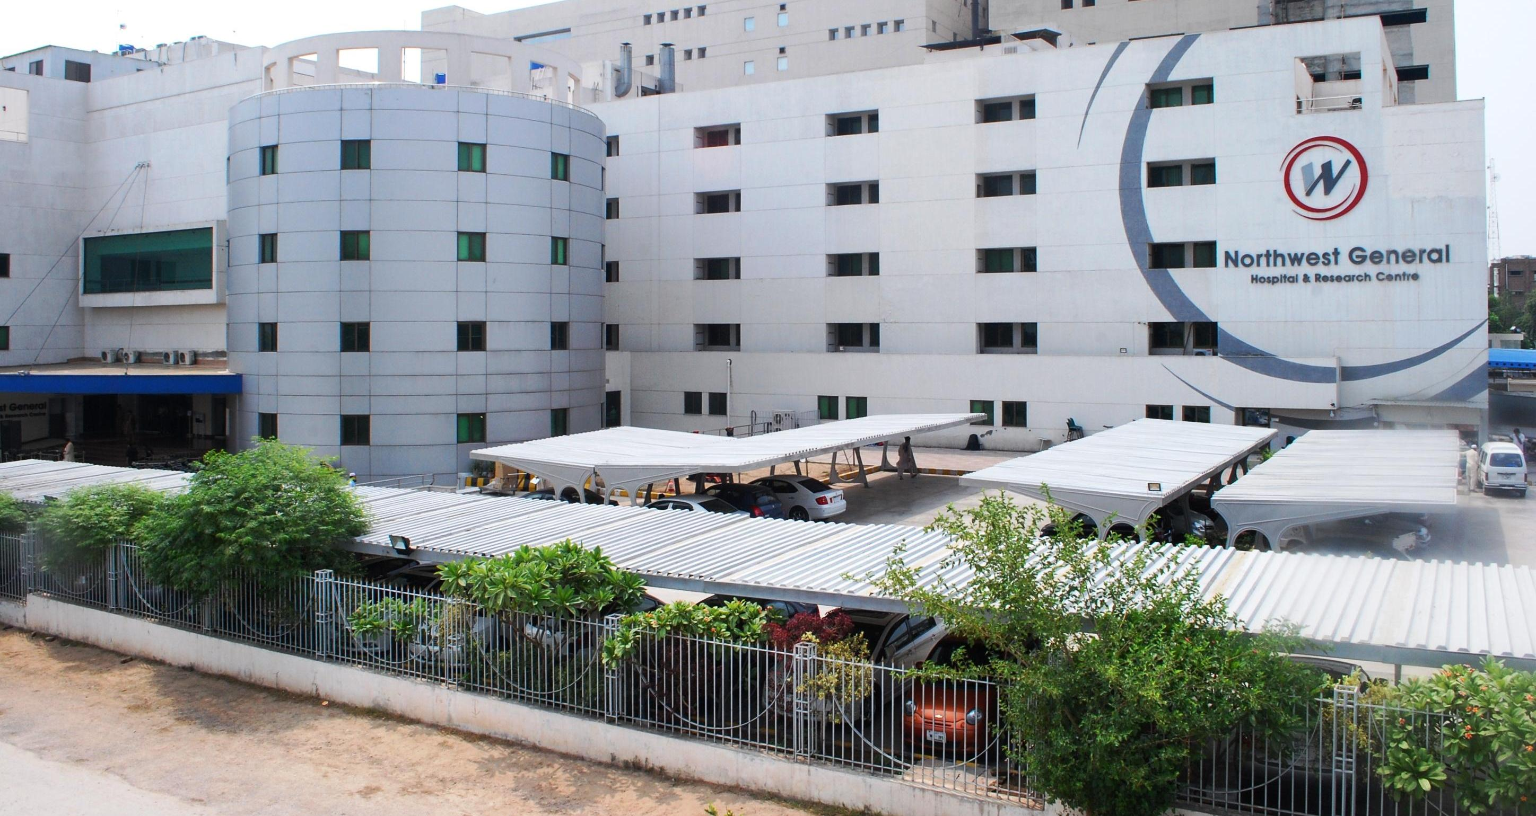
NEUROTRAUMA CARE
In
LOW RESOURSCE SETTINGS
TARIQ KHAN
PESHAWAR , PAKISTAN
Notes:
I WORK IN PESHAWAR PAKISTAN AND AM PRESENTLY CHAIRMAN OF THE NEUROTRAUMA COMMITTEE WFNS

Slide 2

Neurosurgical Cases: 13,000,000/year
Dewan, Park, et al, submitted for publication
 | Brain tumor | Spinal tumor | TBI | TSI | Stroke | HC | NTD | Vascular | Infection | Epilepsy | Total
AFR | 63,343 | 1,032 | 692,937 | 70,032 | 239,675 | 420,674 | 22,942 | 23,564 | 241,910 | 195,039 | 1,971,148
AMR-L | 77,293 | 1,317 | 486,487 | 41,294 | 103,362 | 123,924 | 3,993 | 18,088 | 103,267 | 159,042 | 1,118,066
AMR-US/Can | 56,742 | 1,848 | 326,197 | 9,474 | 71,290 | 33,564 | 1,250 | 13,515 | 2,955 | 59,888 | 576,725
EMR | 53,927 | 1,673 | 495,300 | 17,523 | 178,223 | 89,168 | 4,708 | 2,799 | 32,649 | 157,363 | 1,033,334
EUR | 148,819 | 3,819 | 805,135 | 16,169 | 493,511 | 94,910 | 1,949 | 47,473 | 25,494 | 96,575 | 1,733,853
SEAR | 147,501 | 1,044 | 1,544,232 | 137,389 | 657,300 | 124,708 | 10,394 | 29,657 | 446,085 | 319,221 | 3,417,532
WPR | 187,524 | 7,109 | 1,469,336 | 119,280 | 1,031,871 | 84,369 | 6,864 | 145,684 | 116,641 | 426,298 | 3,594,976
HIC | 181,465 | 5,479 | 1,258,579 | 52,768 | 352,852 | 29,858 | 31,928 | 62,946 | 26,114 | 141,086 | 2,143,075
LMIC | 720,074 | 16,666 | 3,763,608 | 438,524 | 2,407,551 | 740,305 | 3,695 | 95,863 | 701,188 | 1,166,036 | 10,053,510
74% of surgeries for TBI are needed in LMICs
Notes:
Franco Servadei has been saying for years that the bulk of the research on TBI comes from high income countries, but the buden for TBI care is mostly in LMICs. He is right. Our study on estimating the global volume of neurosurgical cases showed that 74% of surgeries that are needed for TBI are outside of high income countries. Please note, the numbers are what is needed based on incidence of moderate and severe TBI, not what is actually being performed. You will soon see that much of the needed cases in the LMICs are not done leading to unnecessary deaths and disabilities.

Slide 3
Neurosurgical Cases: 13,000,000/year
 | Brain tumor | Spinal tumor | TBI | TSI | Stroke | HC | NTD | Vascular | Infection | Epilepsy | Total
AFR | 63,343 | 1,032 | 692,937 | 70,032 | 239,675 | 420,674 | 22,942 | 23,564 | 241,910 | 195,039 | 1,971,148
AMR-L | 77,293 | 1,317 | 486,487 | 41,294 | 103,362 | 123,924 | 3,993 | 18,088 | 103,267 | 159,042 | 1,118,066
AMR-US/Can | 56,742 | 1,848 | 326,197 | 9,474 | 71,290 | 33,564 | 1,250 | 13,515 | 2,955 | 59,888 | 576,725
EMR | 53,927 | 1,673 | 495,300 | 17,523 | 178,223 | 89,168 | 4,708 | 2,799 | 32,649 | 157,363 | 1,033,334
EUR | 148,819 | 3,819 | 805,135 | 16,169 | 493,511 | 94,910 | 1,949 | 47,473 | 25,494 | 96,575 | 1,733,853
SEAR | 147,501 | 1,044 | 1,544,232 | 137,389 | 657,300 | 124,708 | 10,394 | 29,657 | 446,085 | 319,221 | 3,417,532
WPR | 187,524 | 7,109 | 1,469,336 | 119,280 | 1,031,871 | 84,369 | 6,864 | 145,684 | 116,641 | 426,298 | 3,594,976
HIC | 181,465 | 5,479 | 1,258,579 | 52,768 | 352,852 | 29,858 | 31,928 | 62,946 | 26,114 | 141,086 | 2,143,075
LMIC | 720,074 | 16,666 | 3,763,608 | 438,524 | 2,407,551 | 740,305 | 3,695 | 95,863 | 701,188 | 1,166,036 | 10,053,510
89% of surgeries for Traumatic Spine Injuries occur in LMICs
Dewan, Park, et al, submitted for publication
Notes:
Similarly, the burden context for traumatic spine injuries is just as dramatic. 89% of needed spine surgery for trauma are in the developing world. How realistic is it to use the latest generation of spinal implants in a place where the average income is few hundred dollars a month and the operating rooms do not have intra-operative imaging?

Slide 4
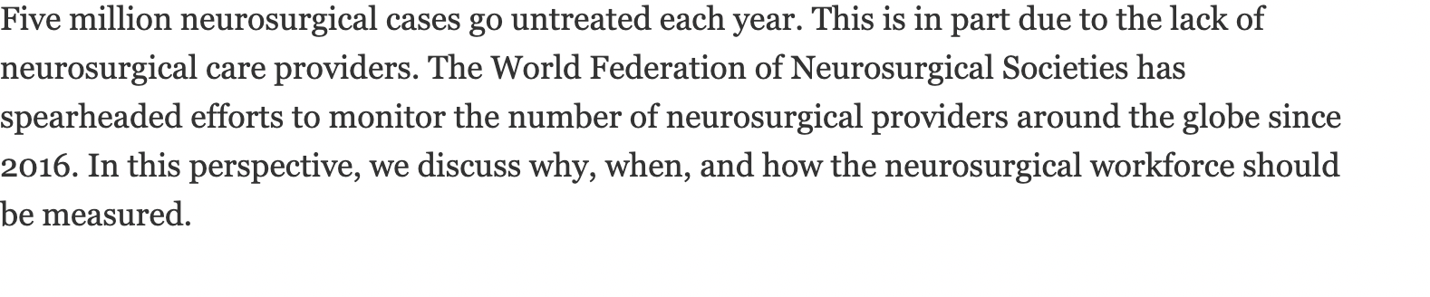

Slide 5
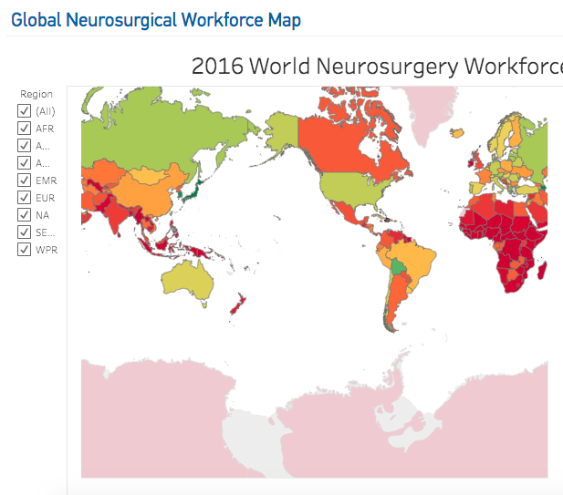

Slide 6
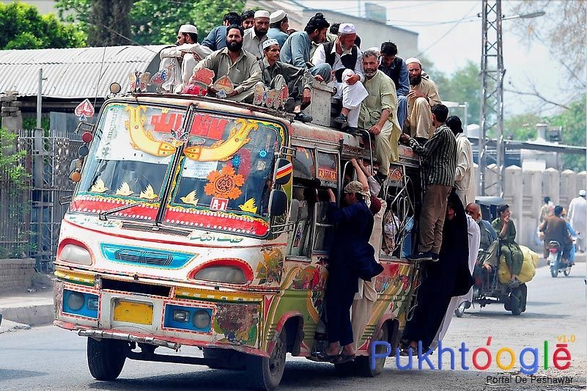
HOW TO HANDLE THE LARGE INFLUX

Slide 7
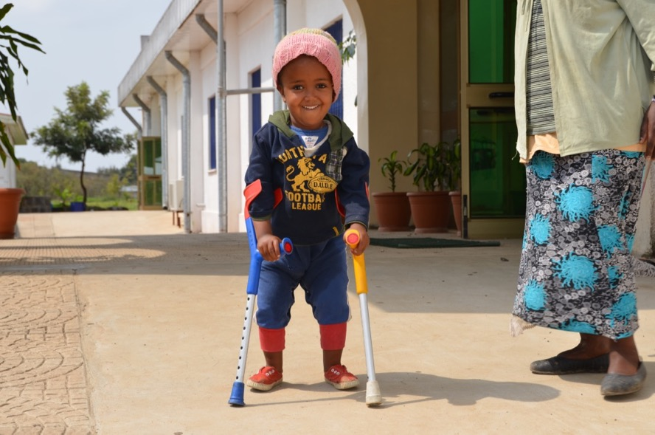
the three “I”s for responding to global neurosurgical needs
  Innovate in low-resource setting
  Inform policy through research
  Integrate into health systems/ UHC

Slide 8
HOLISTIC APPROACH
PREVENTION
PRE HOSPITAL CARE
EMERGENCY ROOM
ICU / THEATRE
WARD CARE
REHABILITATION

Slide 9
AASNS Neurotrauma Survey
2016-2017
northwest general hospital and research centre Peshawar 257
sms (sawai man singh) medical college Jaipur 70
haji adam malik hospital Medan 65
dr soetomo general hospital Surabaya 36
hasan sadikin hospital Bandung 70
rsup sanglah hospital Denpasar 569
1067
Notes:
A SNAP SHOT AUDIT WAS DONE IN 2016 OF HOSPITALS FROM THREE COUNTRIES

Slide 10
Helmet & Seat-Belt Use AANS Survey

Slide 11

ONE HELMET PROTECTS ALL

Slide 12
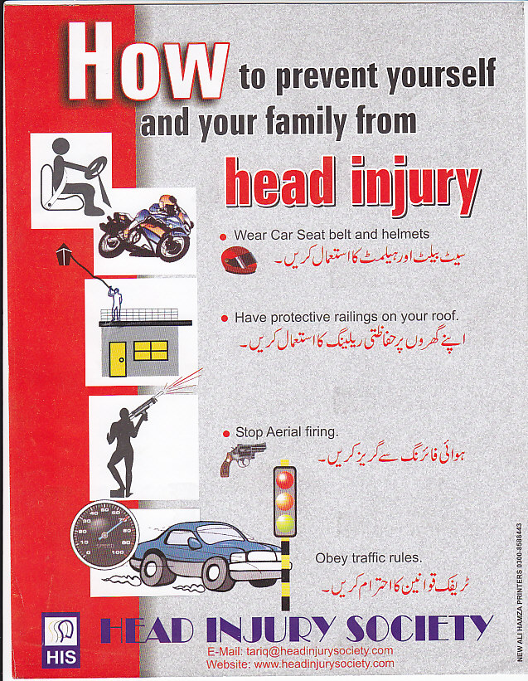
PREVENTION IS BETTER THAN CURE
Notes:
WE ALSO KNOW THAT MOST OF THESE CAN BE PREVENTED FOR US THIS IS THE MOST IMPORTANT PART.
THE NEUROTRAUMA COMMITTEE DECIDED TO HAVE A PUBLIC AWARENESS SEMINAR ON PREVENTION IN ALL FUTURE MEETINGS

Slide 13
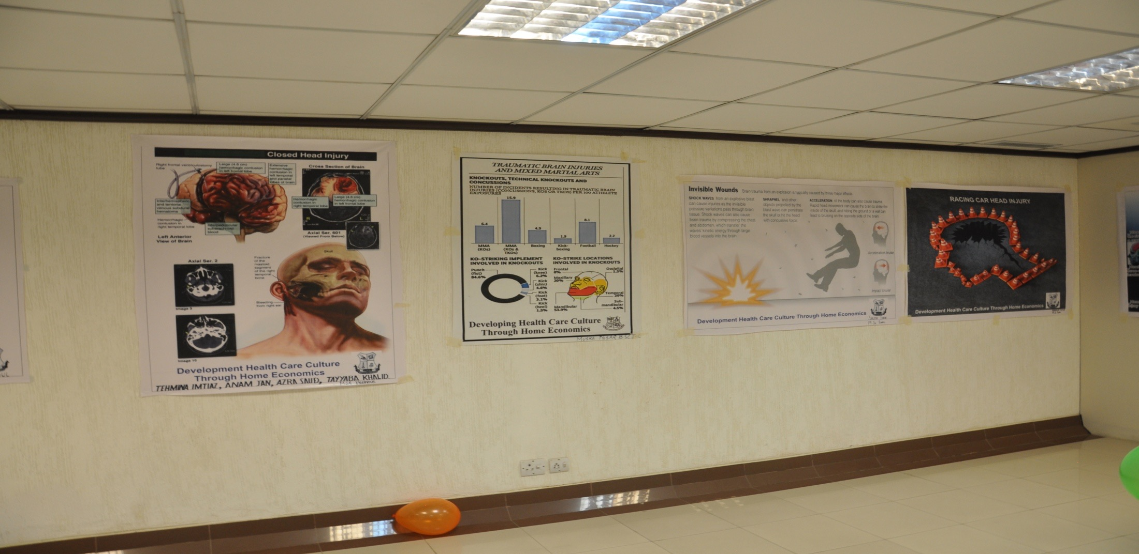
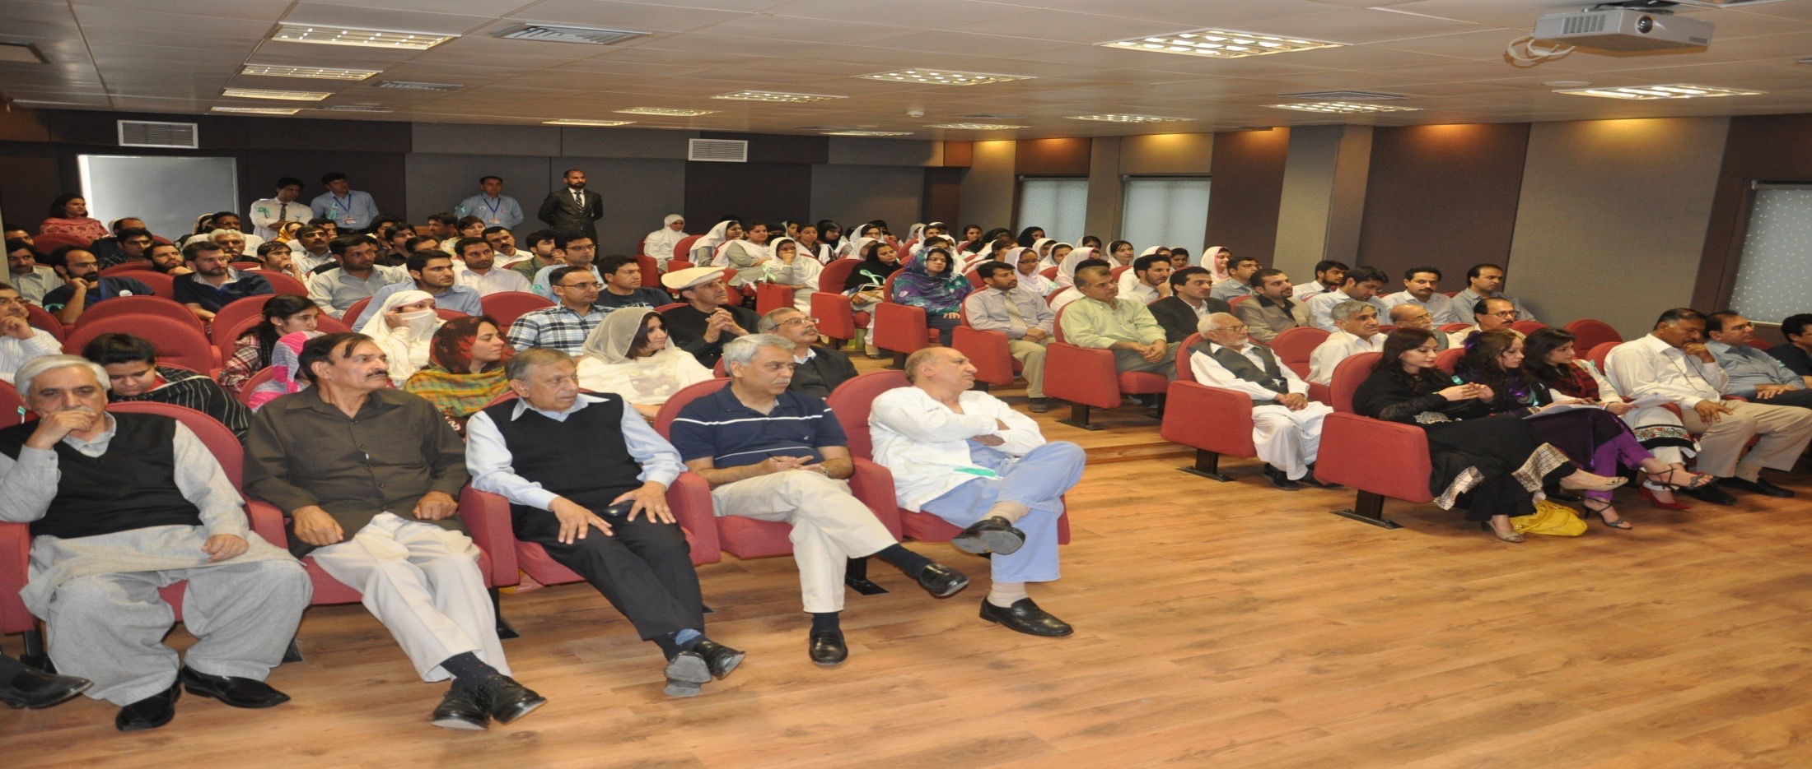
Notes:
WE THE NEUROTRAUMA COMMITTEE IN PAKISTAN HAS BEEN HAVING REGULAR PUBLIC AWARENESS SEMINARS IN DIFFERENT PARTS OF THE COUNTRY SINCE 1997

Slide 14
International Injury Prevention Foundation
Notes:
WFNS NTC DECIDED TO COLLABORATE WITH THIS ORGANISATION FOR PREVENTION .
THIS ORGANISATION IS NOW SPREAD OUT IN MANY COUNTRIES IN SOUTH AMERICA AND ASIA

Slide 15
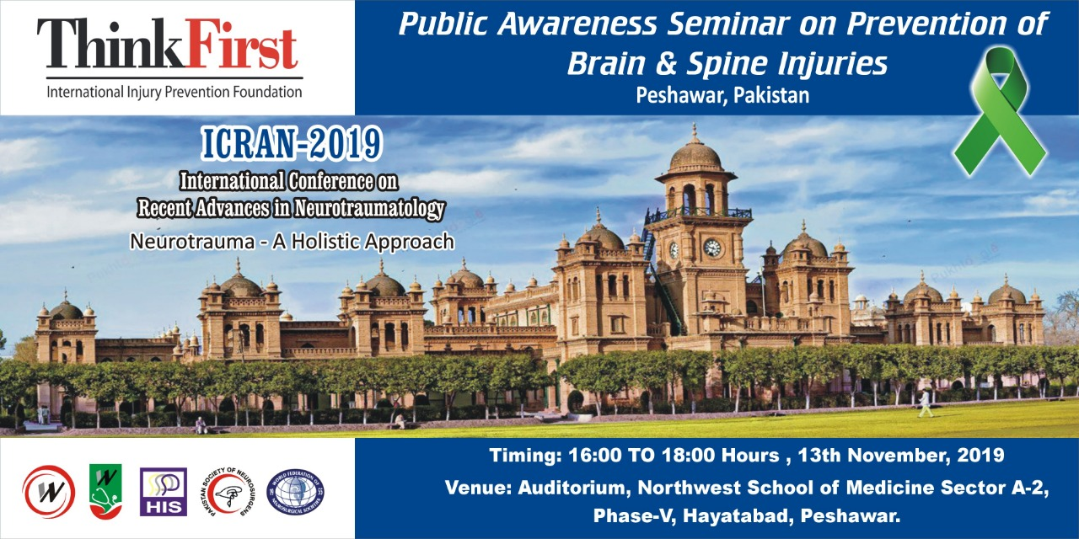
Notes:
AND WE WILL THE FIRST JOINT MEETING NEXT MONTH IN PESHAWAR .
WE ALSO HAVE OPENED UP THE PAKISTAN CHAPTER RECENTLY

Slide 16
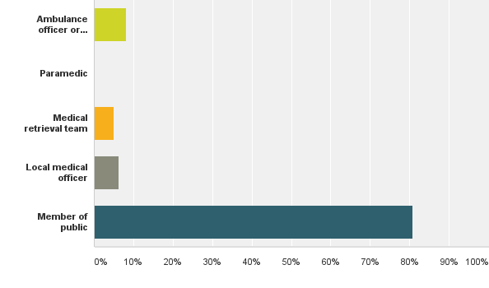
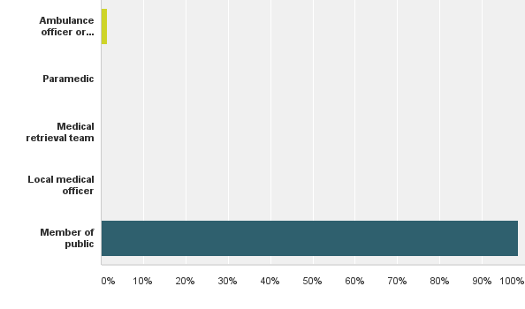
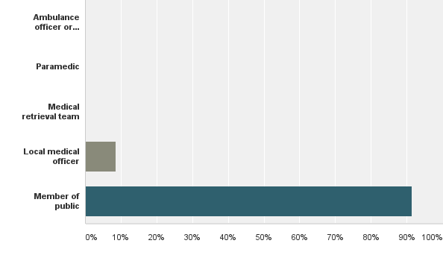
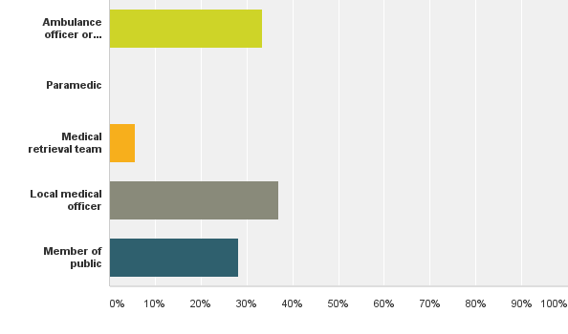
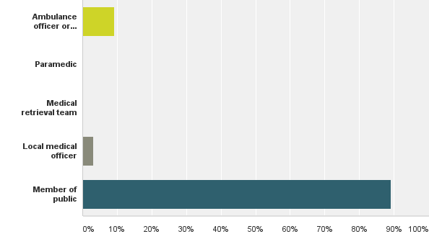
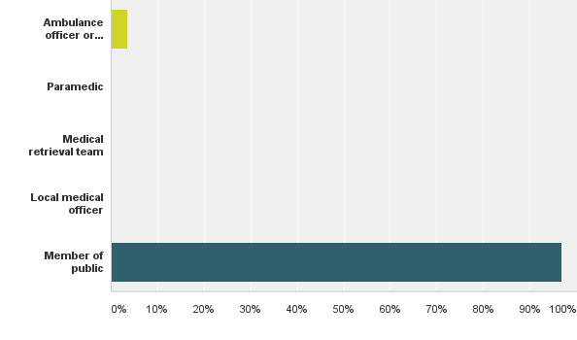
Who provided emergency treatment at the scene of the injury?
Denpasar
Bandung
Surabaya
Peshawar
Medan
Jaipur
Notes:
IT SHOWED THAT THE MAJORITY OF TRAUMA PATINTS WERE ATTENDED BY LAY PEOPLE

Slide 17
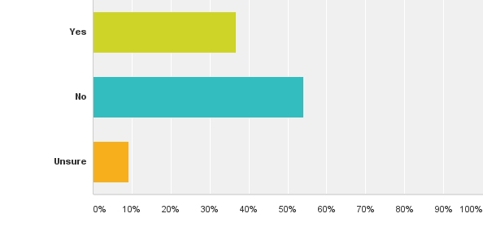
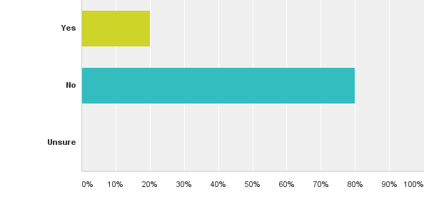
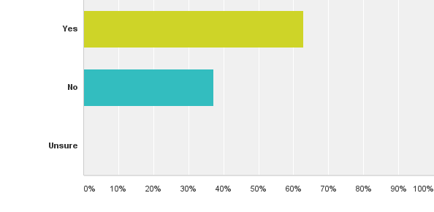
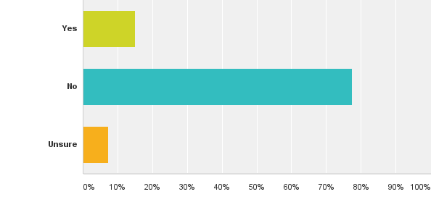
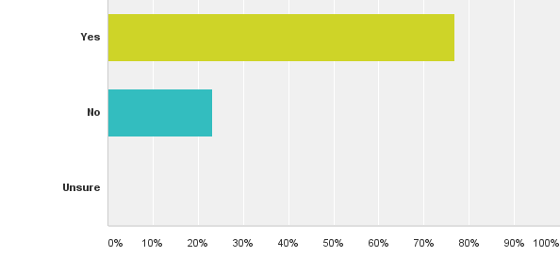
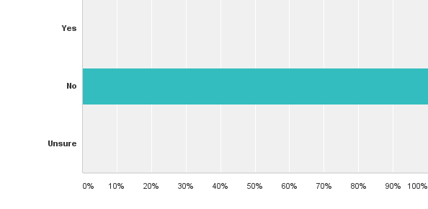
Did a nurse / doctor accompany the patient?
Denpasar
Bandung
Surabaya
Peshawar
Medan
Jaipur
Notes:
BUT THERE WAS NO TRAINED STAFF ACCOMPANYING THE PATIENT

Slide 18
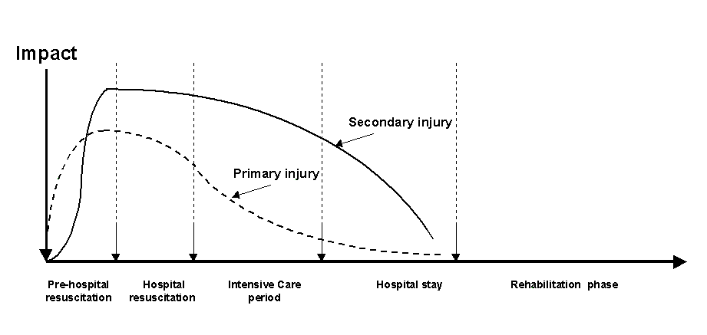
Phases of Injury
50% who die from TBI do so within the 2 hours of injury
50% who die from TBI do so within the 2 hours of injury
40% of pre hospital deaths potentially preventable
Notes:
THE QUICK AND SAFE TRANSFER TO THE REQUIRED FACILITY IS OF UTMOST IMPORTANCE

Slide 19
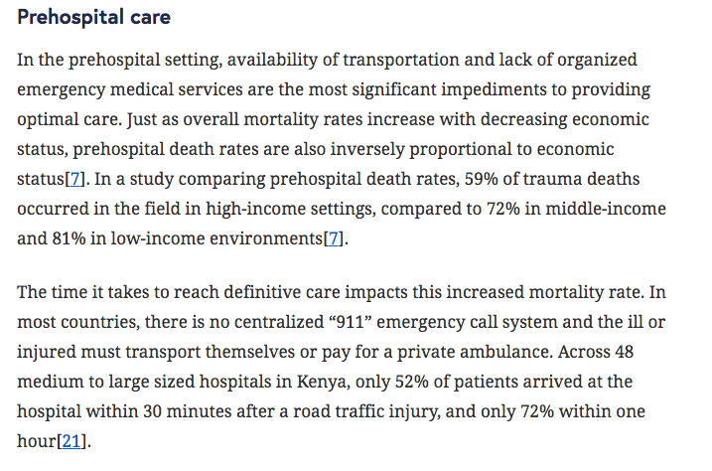

Notes:
59 % PRE HOSPITAL DEATHS WERE SEEN IN HIGH INCOME COUNTRIES AS COMPARED TO 72 % DEATHS IN LOW INCOME COUNTRIES DUE TO LACK OF EMS ON SITE

Slide 20
DURATION TO SURGERY
Notes:
WE CAN SEE HOW LONG IT TAKES FOR PATIENTS TO BE OPERATED. AND CAN HELP IN CONVINCING POLICY MAKERS TO IMPROVE PRE HOSPITAL CARE AND IN HOSPITAL CARE

Slide 21
MANAGEMENT
TREATMENT IS GEARED TOWARDS PREVENTION OF SECONDARY INJURIES AND REHABILITATION
SECONDARY INJURIES LIKE HYPOXIA , HYPOTENSION ,EDEMA , RAISED ICP , LEAD TO INCREASED MORTALITY
LONGER THE DELAY GREATER THE MORTALITY

Slide 22
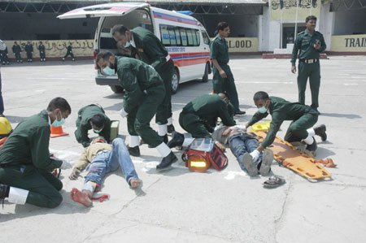
Notes:
THANKS TO EFFORTS FROM SUCCESSIVE GOVERNMENTS AND OTHER ORGANISATIONS THIS IS SLOWLY IMPROVING BUT WE HAVE A LONG WAY TO GO .
I AM SHOWING ALL THIS SO THAT WE ARE CLEAR ABOUT WHERE WE ARE AND WHERE WE HAVE TO GO

Slide 23
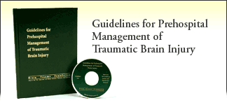
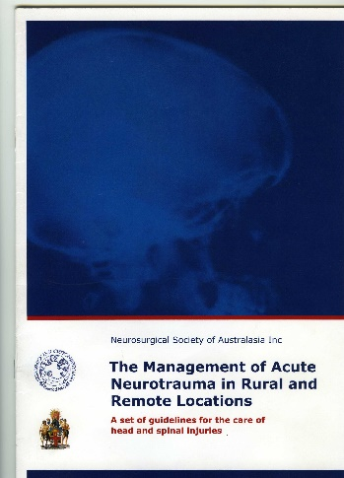
Guidelines
Setting the minimal standards of care from the accident site
Agree on minimal standards of care (core) guidelines
A system of care which grows as trained personnel and resources become available.
Notes:
LOOKING AT THE SCENARIO IT WAS STRESSED THAT GUIDELINES FOR INJURED PATIENTS NEED TO BE LAID DOWN AND THEN FOLLOWED

Slide 24
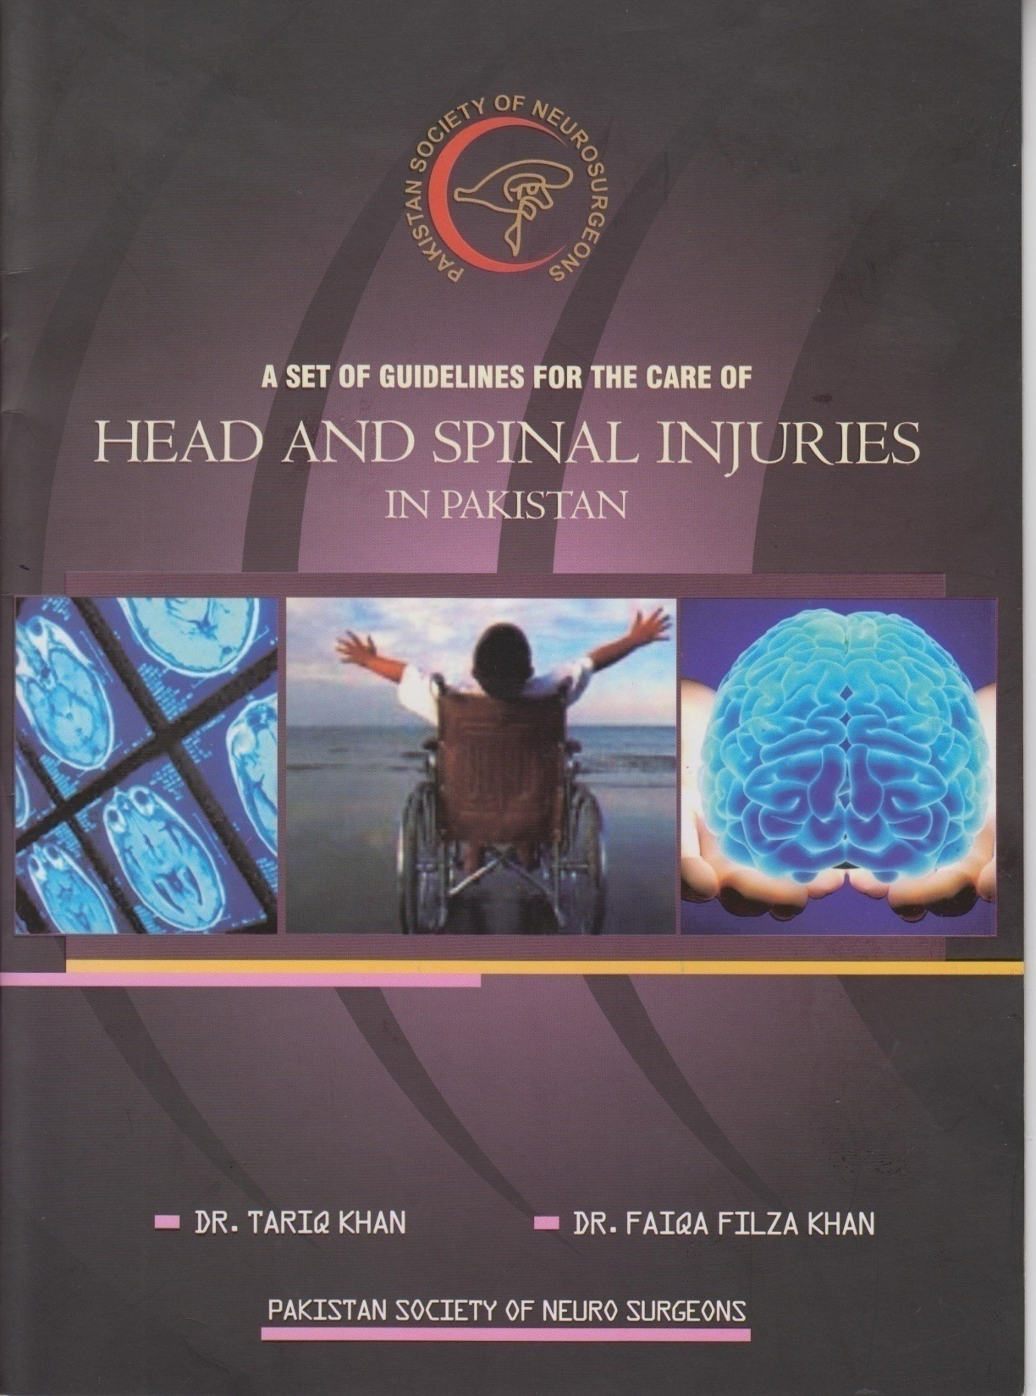
Notes:
WE HAVE TRIED WITH PARTIAL SUCCESS ONLY .
NOW THE NTC HAS FORMED A SMALL TASK FORCE HEADED BY ANDRES RUBIONO FROM COLUMBIA TO DEVELOP MULTILEVEL GUIDELINES , AND HOPE THEY WILL BE PRESENTED AT THE ICRAN IN PESHAWAR IN MARCH

Slide 25
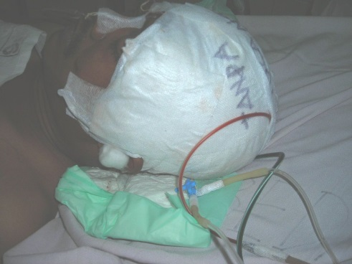
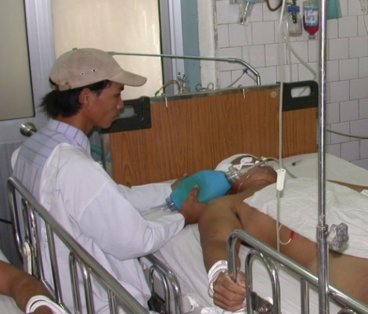
Assessment of need – the epidemiology of trauma- Guidelines need to look at:
the local resources
Profile of injury - the local data
Geography – transport difficulties
Resources - personnel and equipment
Protocols
Notes:
WE MUST ALSO KNOW THE LOCAL DATA .
UNFORTUNATELY THERE IS NO DATA COLLECTION IN MOST LMICs

Slide 26
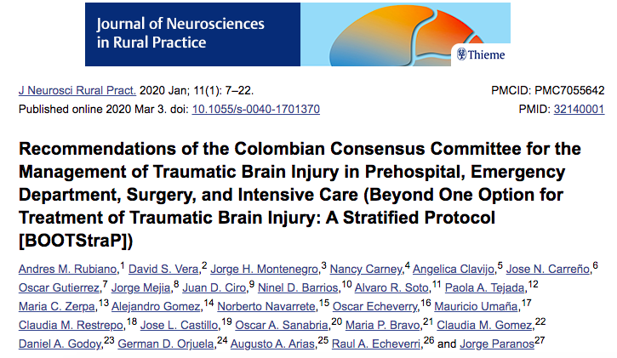

Slide 27
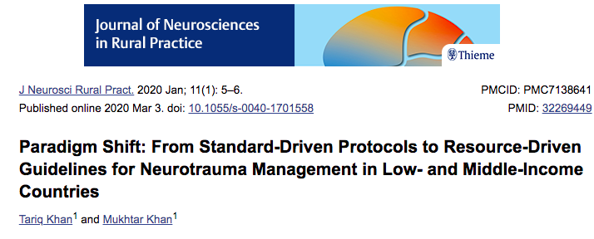

Slide 28
SCOPE OF GUIDELINES
guidelines address treatment interventions, monitoring, and treatment thresholds that are specific to TBI or that address a risk that is greater in patients with TBI
not intended to cover all topics relevant to the care of patients with severe TBI. Topics related to general good care for all patients, or all trauma patients, are not included.
These recommendations are intended to provide the foundation on which protocols can be developed that are appropriate to different treatment environments.

Slide 29
AREAS COVERED
PREHOSPITAL CARE
EMERGENCY ROOM CARE
SURGICAL THEATRE CARE
ICU CARE

Slide 30
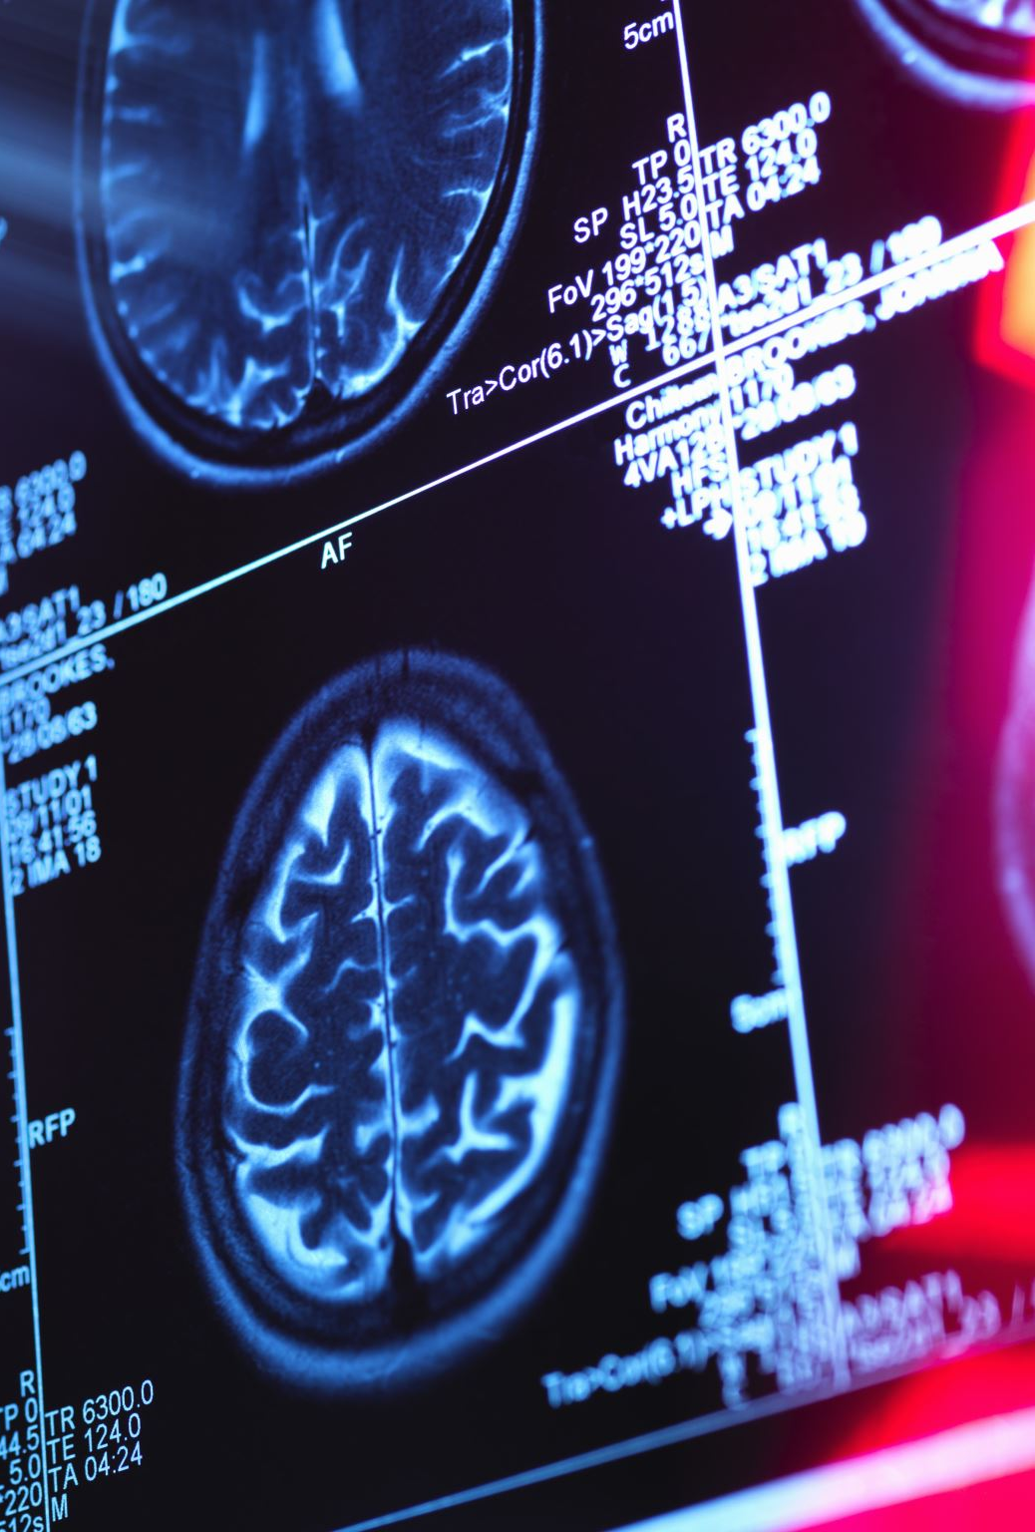
IN HOSPITAL MANAGEMENT GUIDED BY :
GCS MONITORING
CT SCAN
ICP MONITORING
PUPILLARY RESPONSE
GOAL IS SUPPORTIVE TREATMENT AND PREVENTION OF SECONDARY DAMAGE

Slide 31

BRAIN TRAUMA FOUNDATION GUIDELINES
EVIDENCE BASED
General maneuvers –
head elevation & neutral position (to avoid venous congestion)
normothermia
sedation,
volume resuscitation
First line therapy – CSF drainage, hypocapnia (PaCo2 30-35mmHg), mannitol administration , 3% Saline
Second tier – high dose barbiturates, intense hyperventilation (PaCo2- <30mmHg), increase in mean arterial pressure, mild to moderate hypothermia, decomrpressive craniectomy

Slide 32
BTF RECOMMENDATIONS
LEVEL 2 A EVIDENCE THAT
BIFRONTAL DC HAS BEEN SHOWN TO REDUCE ICP AND STAY IN ICU
BUT NOT THE GOS-E OUTCOME AT SIX MONTHS
A LARGE FRONTOTEMPOROPARIETAL DC AT LEAST 12 BY 15 CM FOR REDUCED MORTALITY AND IMPROVED NEUROLOGIC OUTCOME

Slide 33
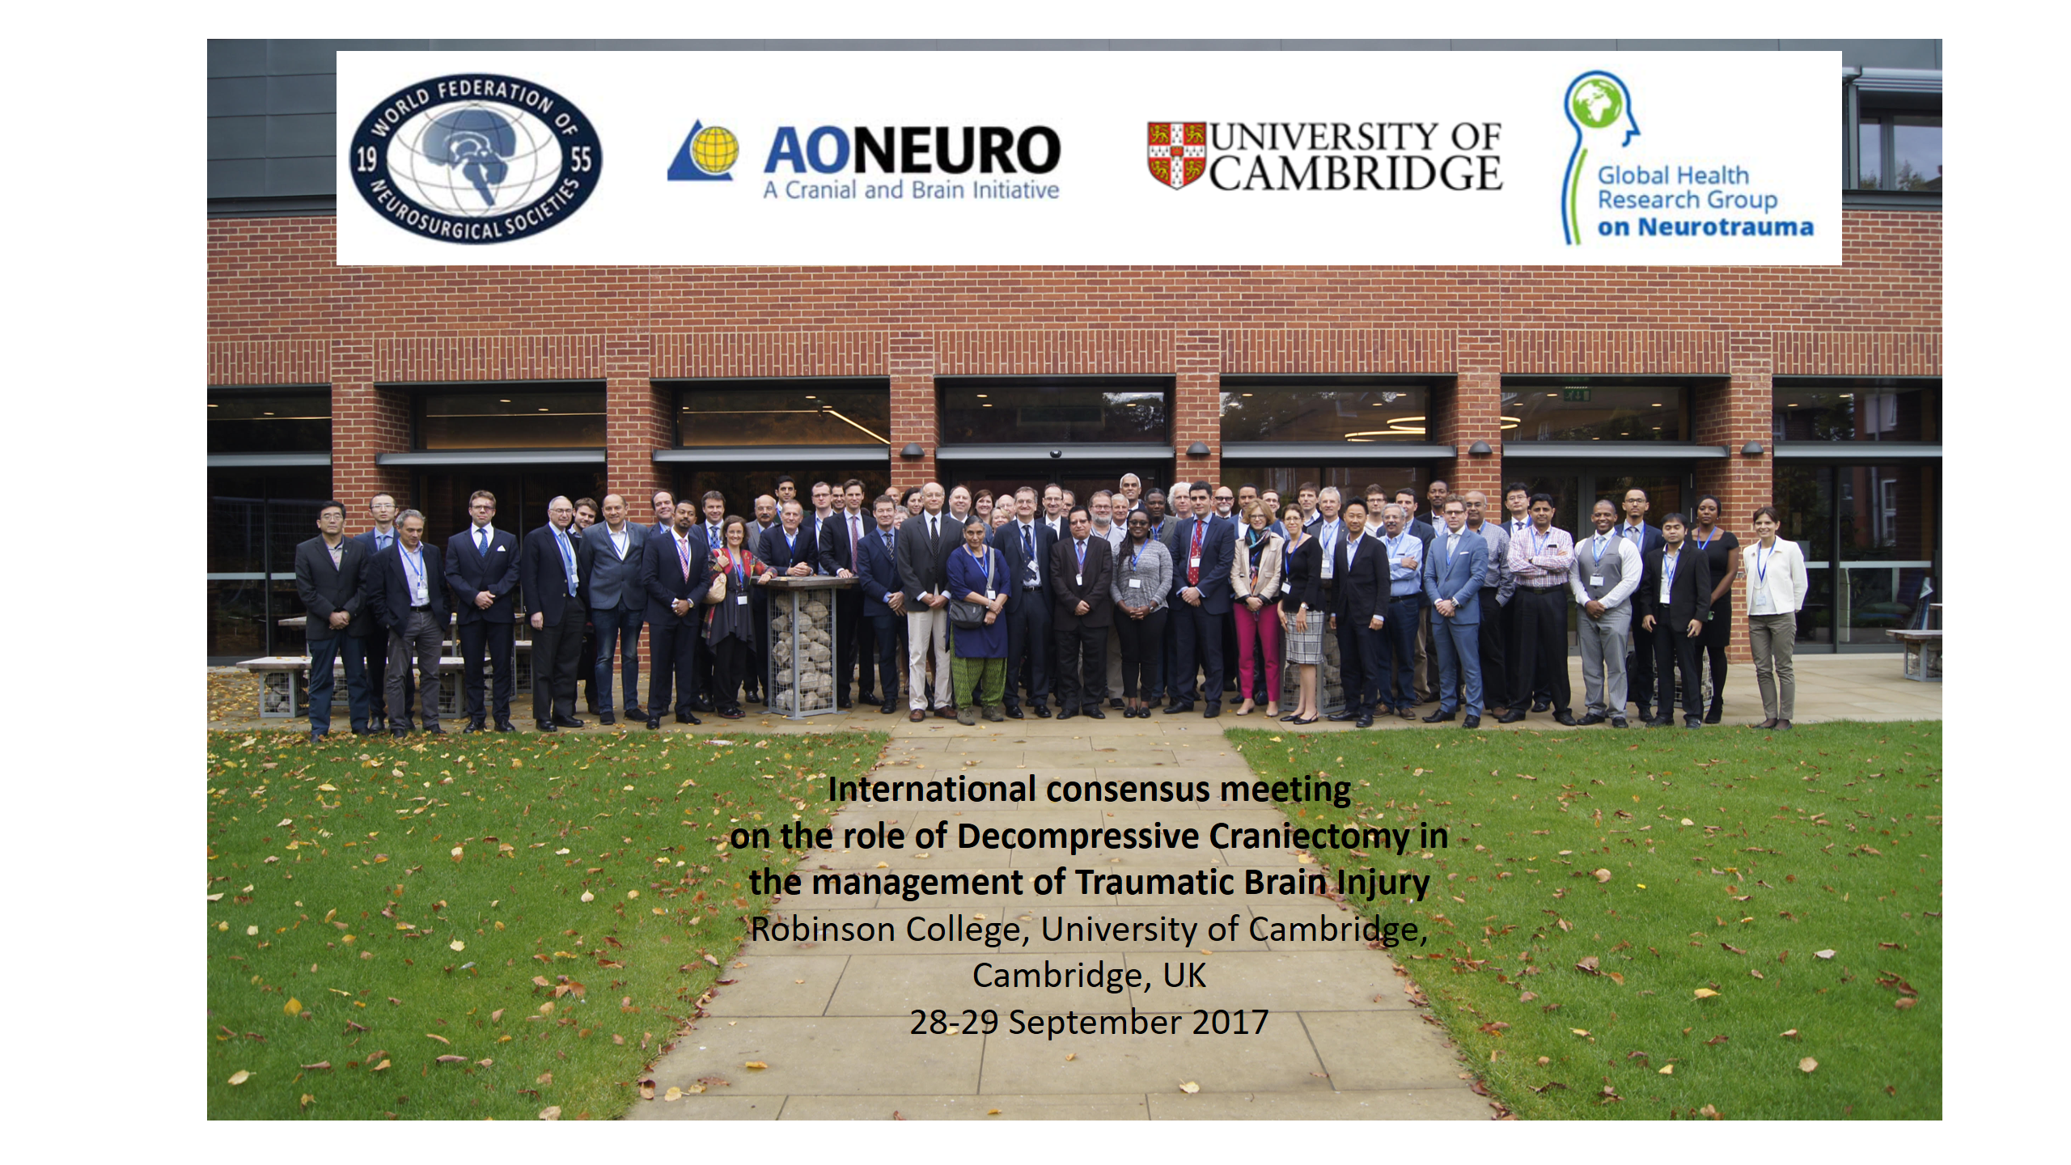
Aiming for open access publication in the next few months

Slide 34
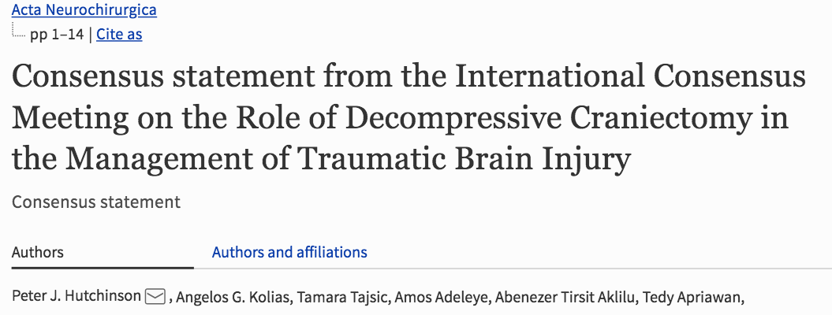

Slide 35
ICP MONITORING
LEVEL 2B
DATA FROM ICP MONITORING REDUCES HOSPITAL STAY AND TWO WEEK POST INJURY MORTALITY
ICP SHOULD BE MONITORED IN ALL SALVAGABLE PATIENTS WITH GCS 3-8 AFTER RESUSCITATION WITH CT CHANGES
ICP MONITORING IS INDICATED IN SEVERE TBI WITH NORMAL CT BUT HAVING TWO OR MORE FEATURES ON ADMISSION – AGE GREATER THAN 40 , UNILATERAL OR BILATERAL MOTOR POSTURING OR SBP < 90

Slide 36
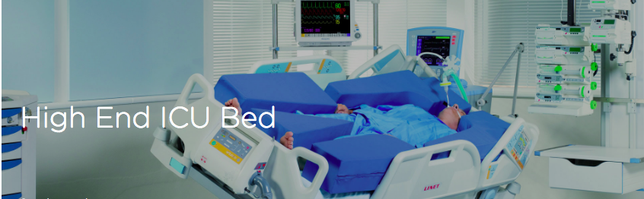

Slide 37
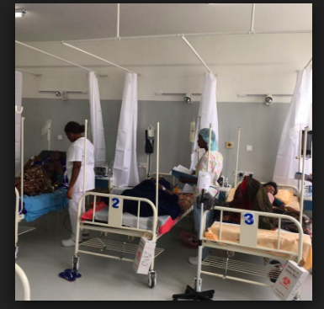
LMIC CRITICAL CARE

Slide 38
GUIDELINES FOR LMICs
majority of severe traumatic brain injury (sTBI) patients globally are managed without ICP monitoring (23-89% cases in high income countries)
No recent literature to guide management in non-monitored patients
Large part of literature comes from well-equipped, larger centres in HICs
No resource based guidelines in LMICs to guide sTBI management

Slide 39
BEST TRIP trial ( 2012 ) provides the only tested non-ICP monitored treatment protocol ( CHESNUT et al )
This trial found no evidence of outcome difference for monitored & non-monitored patients
This trial compared ICP monitored patients vs non-monitored (Imaging and Clinical Exam [ICE] protocol)

Slide 40
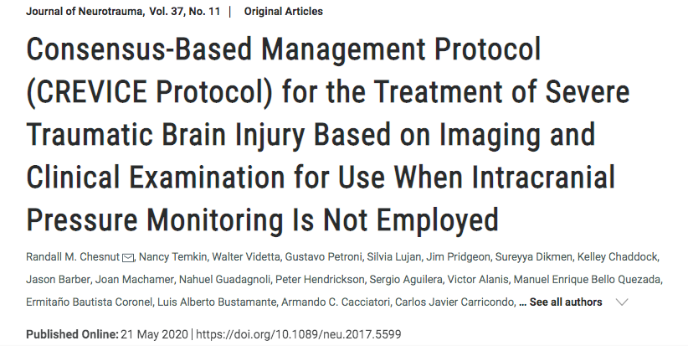

Slide 41
Consensus revised ice protocol
The CREVICE protocol
not a substitute but a supplement for empirical evidence
effort to provide for the vacuum left by absence of evidence based guidelines
Developed using the Delphi technique
43 intensivists and neurosurgeons

Slide 42
HOW WE DO IT
DECOMPRESSIVE CRANIECTOMY ON ADMISSION
ICP MONITORING THROUGH INTRAVENTRICULAR CATHETER
CREVICE PROTOCOL

Slide 43
Indications for Decompressive Craniectomy
In Trauma
CT scan findings: diffuse brain edema
with or without brain contusions and subdural hematoma.
The effacement of basal cisterns and ventricles.
-⁺Midline shift ≥ 5 mm
GCS: 9-12 (or drop of 2 degrees from previous)
AGE Less than 70 ( over 70 there is 75 % mortality )
Refractory ICP

Slide 44
MANAGEMENT PROTOCOL
CREVICE
MARSHALL SCORE ON CT BRAIN
INTERVAL CT SCANS
CLINICAL SCORE ( GCS ) NEURO WORSENING
PUPILLARY RESPONSE
FOUR TIERED MANAGEMENT RESPONSE

Slide 45
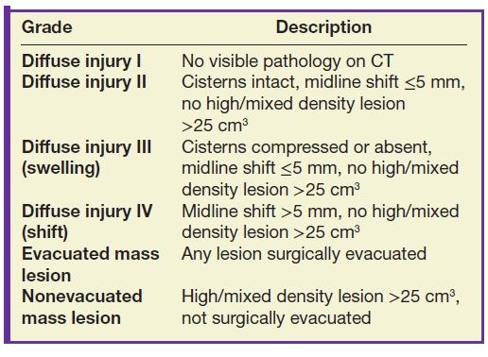
MARSHALL GRADING
CISTERNS , MIDLINE SHIFT , MASS LESION

Slide 46
Intracranial hypertension is suspected and treatment is recommended in the presence of one Major or two Minor criteria: ( SICH )
Major Criteria are:
  1. Compressed cisterns (CT classification of Marshall diffuse injury III)
  2. Midline shift > 5 mm (Marshall diffuse injury IV)
  3. Non-evacuated mass lesion.
Minor Criteria are:
  1. GCS motor score of 4 or less
  2. Pupillary asymmetry
  3. Abnormal pupillary reactivity
  4. CT classification of Marshall diffuse injury II (i.e. basal cisterns are present with midline shift 0-5 mm and/or high- or mixed-density lesion of 25 cm3 or less).

Slide 47
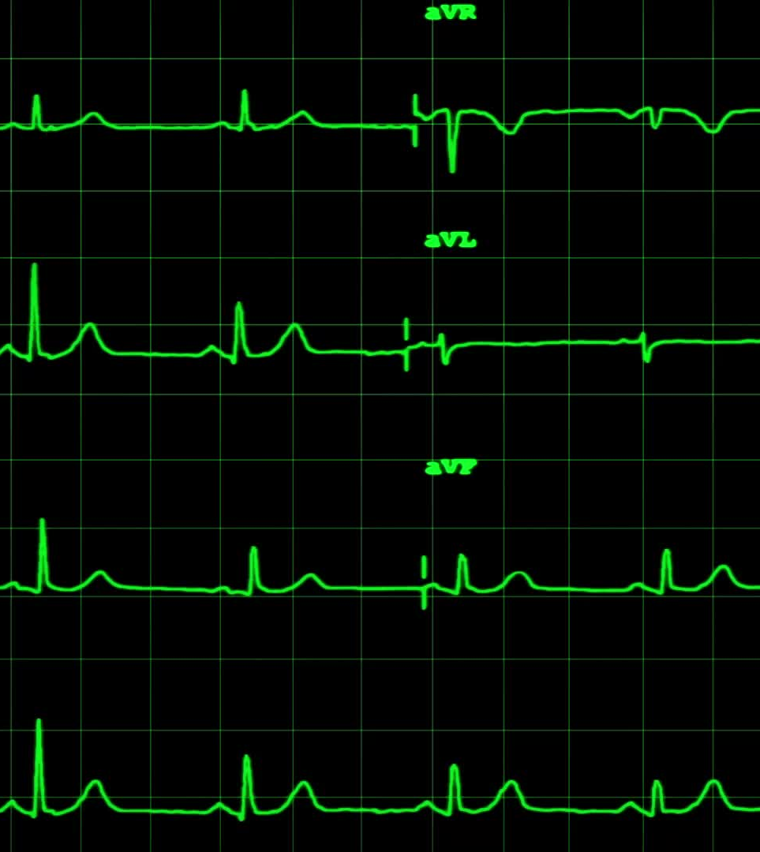
1. Neuro worsening
  a. Decrease in the motor GCS of 1 or more points
  b. New loss of pupil reactivity
  c. Interval development of pupil asymmetry of > 2mm or bilateral
  Mydriasis
  d. New focal motor deficit
  e. Herniation syndrome (e.g., Cushing’s triad)

Slide 48
Imaging schedule
Initial
Repeat at ≥12 hours if initial done at ≤4 hours
24 hours
48 hours
PRN

Slide 49
Tier 1
Scheduled hypertonic saline (for example, 4 hourly)
Scheduled mannitol (for example, 4 hourly)
Maintain Normothermia (threshold = 37.5º)

Slide 50
Tier 2
Hyperventilation, PaCO2 = 30-35 mmHg
Hypertonic saline 3% by continuous infusion
Increase in sedation

Slide 51
Tier 3
Decompressive craniectomy
High dose IV barbiturates
Hypothermia (central temperature range < 37ºC)
CONTROVERSIAL

Slide 52
TIER 4
UNTESTED PROTOCOLS
HYPERVENTILATATION
HYPOTHERMIA
NIMODIPINE
MAGNESIUM

Slide 53
Escalating the tiered therapy
Escalation of therapy (or adding another treatment) should be considered for the following:
Neuroworsening
Decrease in the motor GCS of 1 or more points
New loss of pupil reactivity
Interval development of pupil asymmetry of > 2mm or bilateral mydriasis
New focal motor deficit
Herniation syndrome (e.g., Cushing’s triad)
No improvement or worsening on follow-up CT imaging
No acceptable response to initial therapy

Slide 54
Suspicion of high ICP
Yes
Maintain intubation
Ventilation, Analgesia
Sedation, MAP ≥90
Observation
Initiate Tier 1
Abnormal CT
Neuro-worsening
NO
Non-tiered therapies
Hyperventilation
Diuretics
Yes
Yes
Neuro-worsening
Treatment Weaning
Yes
Escalate Therapy
Next Tier
Neuro-worsening
Yes
Abnormal CT
Neuro-worsening
NO

Slide 55
Do not wean
SICH Tx
NO
Neuro-exam
Stable/improving
Delay weaning
Pupils
GCS motor score
Marshall CT score
Treatment weaning
NO
Decision to Wean
Overall clinical picture
favourable
YES
Discontinue recently added tx
MAP Threshold 80 mmHg
Proceed with caution

Slide 56
CREVICE DECISION SUPPORT MATRIX
( MARSHALL SCORE , PUPILS, MOTOR RESPONSE )
Marshall CT Class DI = Diffuse injury class EML = Evacuated mass lesion |  | GCS Motor Score & Pupils [NP = Normal pupils] [AP = abnormal pupils]
 |  | GCS M6 |  | GCS M5 |  | GCS M4 |  | GCS M 1-3
First 24 hours |  | NP | AP | NP | AP | NP | AP | NP | AP
 | DI 1 & 2
 | EML/DI 1-2
 | DI 3
 | EML/DI 3
 |  | NP | AP | NP | AP | NP | AP | NP | AP
After 48 hours | DI 1 & 2
 | EML/DI 1-2
 | DI 3
 | EML/DI 3
Legend
Green | Safe to Wean
Yellow | Caution
Red | Do not Wean

Slide 57
CREVICE DECISION SUPPORT MATRIX
Marshall CT Class |  | GCS Motor Score & Pupils [NP = Normal pupils] [AP = abnormal pupils]
 |  | GCS M6 |  | GCS M5 |  | GCS M4 |  | GCS M 1-3
 |  | NP | AP | NP | AP | NP | AP | NP | AP
72 hours | DI 1 & 2
 | EML/DI 1-2
 | DI 3
 | EML/DI 3
 |  | NP | AP | NP | AP | NP | AP | NP | AP
After 72 hours | DI 1 & 2
 | EML/DI 1-2
 | DI 3
 | EML/DI 3
Legend
Green | Safe to Wean
Yellow | Caution
Red | Do not Wean

Slide 58
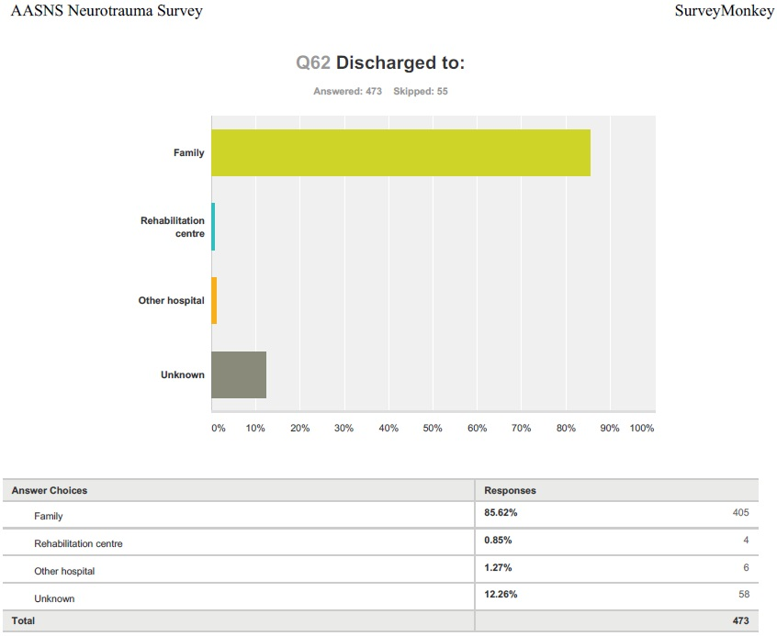

Slide 59
REHABILITATION
ONE OF THE MOST IMPORTANT PART AND WHICH IS OFTEN NEGLECTED IN DEVELOPING COUNTRIES DUE TO POOR RESOURCES
MULTIDISCIPLINARY
ROLE OF DBS ?
ROLE OF FAMILY MEMBERS

Slide 60
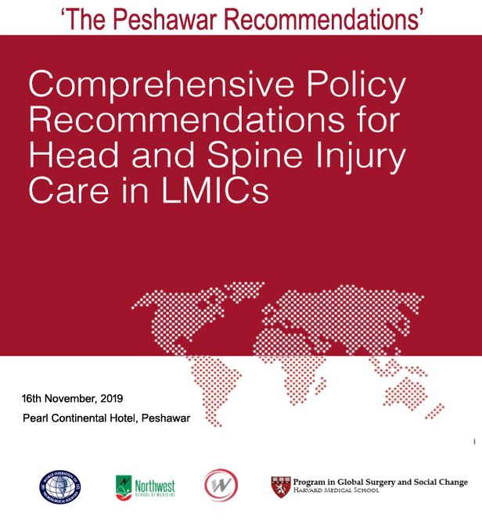

Slide 61
3. Creating a Vision
Need for a unifying vision for Global Neurosurgery
“80% of the world has access to essential neurosurgical care by 2030”
“80% of the world is within 4 hours of a neurosurgical center by 2030”
“90% of LMICs with National Neurotrauma Plan in place by 2021”

Slide 62
Timeline
Bogota Declaration 12/2016
ICRAN Peshawar 3/2019
WFNS Beijing 9/2019
Weill Cornell GN Symposium 1/2019
WFNS Bogota 2022
2030

Slide 63


Slide 64
Global Neurosurgery
In addition to doing neurosurgery better,
how to better deliver neurosurgical care to all who need it
Notes:
Neurosurgeons excel at pushing the limits of surgical technique . The technical advances are remarkable. However, Global neurosurgery is about asking ourselves, are the people who need neurosurgical care actually getting the services when they need it wherever they may be? AND YOU are well aware that the answer is sadly, no.

Slide 65


LAUNCHING OF THE GLOBAL NEUROSURGERY COMMITTEE
ICRAN 2019
Peshawar, Pakistan

Slide 66


OBJECTIVES
To achieve universal access to neurosurgical care
To align and coordinate all global neurosurgery activity within WFNS to reaching the goal.
To stimulate and facilitate relevant research to inform policy.
To engage with surgical stakeholders for building integrated surgical systems
To co-advocate for investing in surgical care for all within Universal Health Coverage

Slide 67
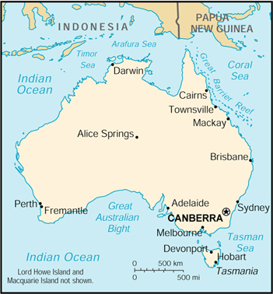
Neurosurgery by non neurosurgeons?
“the tyranny of distance”
Darwin:
population 190,000
2,600km from a neurosurgical service so general surgeons perform all emergency neurosurgery
From 2008 to 2013: 33 cases per year.
Mortality: EDH & Ch SDH = 0
Ac and subac SDH = 33%
ICH = 36%
Luck et al, ANZ J Surg 2015
Notes:
THERE HAS BEEN A LOT OF DISCUSSION ON THIS ISSUE , AND ONE SUCCESSFUL MODEL IS IN AUSTRALIA

Slide 68
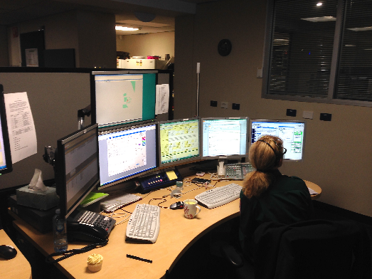

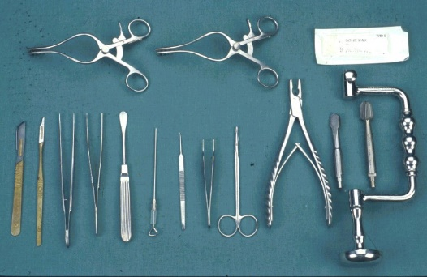
Support for the Local Surgeon
Training and feed back
Teleradiology, Skype…
Virtual surgical assistant
Guidelines
Communication
Guidelines
Local Expertise
Notes:
NOW WITH ALL THESE FACILITIES IT MAY BE EASIER FOR TRAINING SUPPORTING AND MONITORING NON NEUROSURGEONS

Slide 69


Slide 70
